Slide 1
Gray level Transformation
There are three basic gray level transformation.
Linear (Negative Transformation)
Logarithmic (Log transformation)
Power – law (Power – Law transformations)

Slide 2
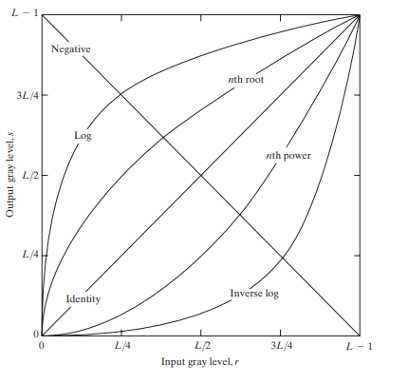
Logarithmic Transformation
Equation of Logarithmic transformation
S = C log( r + 1)
S = Logarithmic image (Pixel value)
C = constant
R = Intensity of pixel.

Slide 3
S = C log( r + 1)
Original Image
Logarithmic Image
( C = 1 )
0 | 255 | 127
10 | 250 | 50
200 | 100 | 50
0 | 2.4 | 2.1
1.04 | 2.39 | 1.70
2.30 | 2.00 | 1.70
8-bit & (3 X 3) Image

Slide 4

How you can find perfect “c” ?
C = Constant in Logarithmic Transformation
Max Pixel Intensity in image = L – 1 (Mostly)
For Ex, 8 bit image L = 256 so max intensity of pixel can be 255.
In case of 8 bit image Perfect C is 106.25, Approximately 106.
0 | 254 | 223
110 | 255 | 180
243 | 212 | 113
Logarithmic Image with C = 106.

